Slide 1
AAA in Arrowhead
Hegedűs Csaba (hegeduscs@aitia.ai)
Plósz Sándor
Pál Varga
Gábor Soós
AITIA Inc.
Budapest University of Technology

Slide 2
Security requirements - CIAAA
Confidentiality:
Encryption, proper key exchange
(Message) Integrity:
Encryption, digest or signature
Authenticity:
Parties are able to verify identify of each other
Availability:
Resource planning, redundancies
Accountability:
Logging
Governance of resources and information
Notes:
Also:
We have to differentiate between private data and that of public interest.
We have to protect the systems that provide such data approprietly.

Slide 3
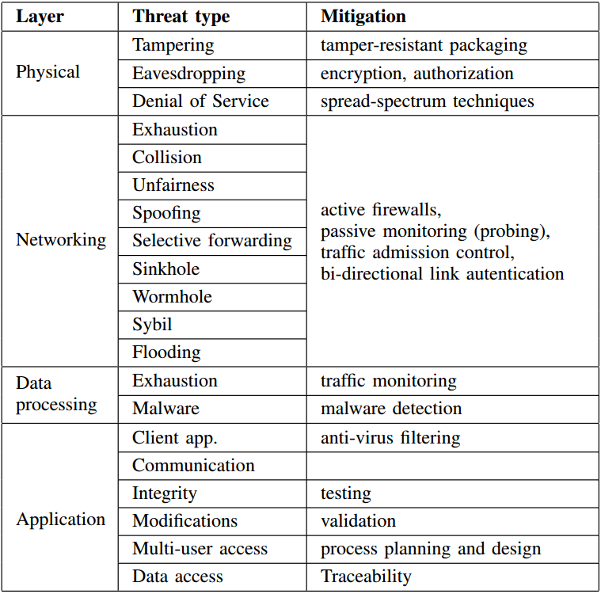
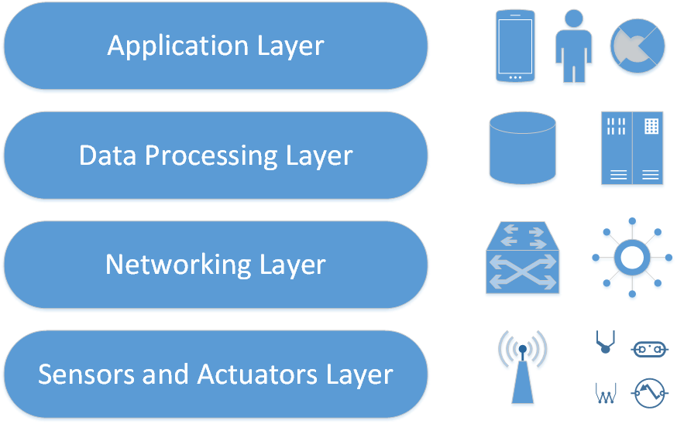
Threats in IIoT

Slide 4
A - A – A within Arrowhead
Authentication
Identity verification (@ Core Systems and @ other App. Systems)
Authorization
Admission into Local Cloud (when System wakes up):
does this System belong to us?
„Bootstrapping mechanism” is required, see Future Work
Access rights management (are you entitled to use that?)
For local scenarios: intra-Cloud authorization rules
For inter-Cloud authorization
Admission control (per transaction/session; at Service Provider side)
The final release of service data is the right of the Service Provider!
Accounting
Services consumed/session start-end with timestamps
This should be a Core System (e.g. Historian?)
Under design (within G3.2)

Slide 5
Previous solution(s)
Ticketing-based Authorization: uses UDP and immutable tickets
Only an authentication solution, not authorization!
System A
1. Request token (+authentication)
2. Check credentials
5. Return token
AAA System
Radius Server
6. Access request
9. Access response
7. Request token validation
3. Check response
System B
8. Validation response
4. Generate token

Slide 6
Shortcomings of RADIUS-based ticketing
Authentication info sent unencrypted
Communication overhead (authentication server always in the loop)
Token does not bind any identity – can be captured and re-used (immutable ticket sent over UDP)
Not flexible and not scalable

Slide 7
Shortcomings of Generation 3.0
AuthorizationControl service:
Stores X.509 certificate CN-s partially, retrieves CN on request
The Service Provider is only capable of:
Verifying whether the inbound certificate CN overlaps with the stored CN
This solution can be bypassed very easily:
Generate a self-signed certificate with a CN that matches the stored CN
The Provider cannot verify the certificate chain from the AuthControl service
Unless it has root cert-s for all vendor-specific certificates (for all device types in the Local Cloud)
That solution is not scalable or possible when there are more than one vendor of certificates in a Cloud.
Solution is only adequate when a specific certificate hierarchy is implemented:
There is a root of trust („cloud certificate”) in which all Systems trust
Every AppSys certificate shall be signed by the Cloud cert.
This way the trust stores can be set up properly.
G3.2 implements this hierarchy → a specific BOOTSTRAP mechanism is required

Slide 8
G3.2 security features and concepts

Slide 9
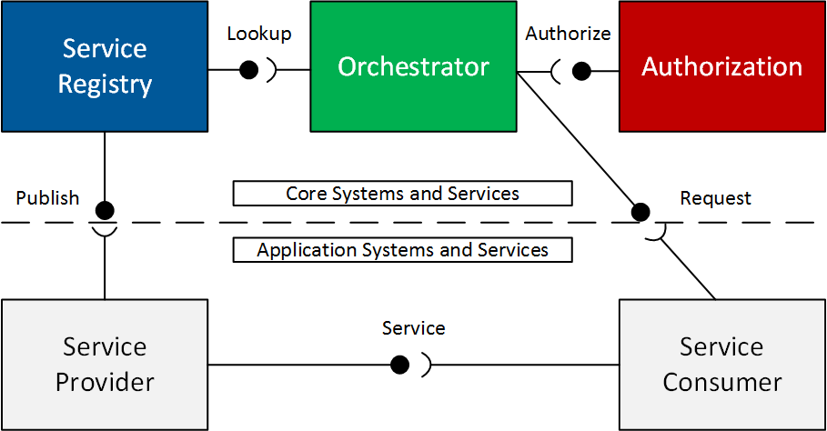
G3.2 core interactions (in the most secure scenario: centralized session control)
Notes:
Introduction and goals of AH
Local Clouds work in SOA.
There are the mandatory core systems, that offer basic governance.
Authorization now bears two tasks: access control information, token gen.
SR: now capable of cleaning up the database, implements service metadata with every offering separately.
Gatekeeper has two services: GSD, ICN.
Network Manager will be required to build up inter-cloud data end-to-end path.

Slide 10
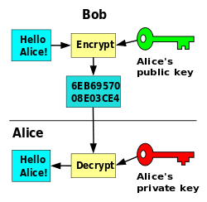
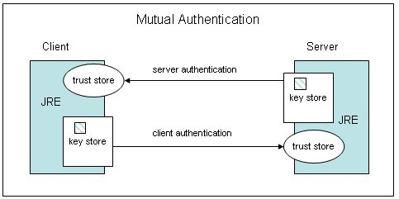
G3.2 uses X.509
Private and Public keys (PKI!)
Trust stores and key stores within Systems set up in an Arrowhead way
Arrowhead Chain of Trust; Local Certificate Agents;
AH Master CA
- May be self-signed
Cloud 1 CA
Cloud 2 CA
System A Certificate
System B Certificate
…
System M Certificate
System N Certificate
System O Certificate
…
System X Certificate

Slide 11
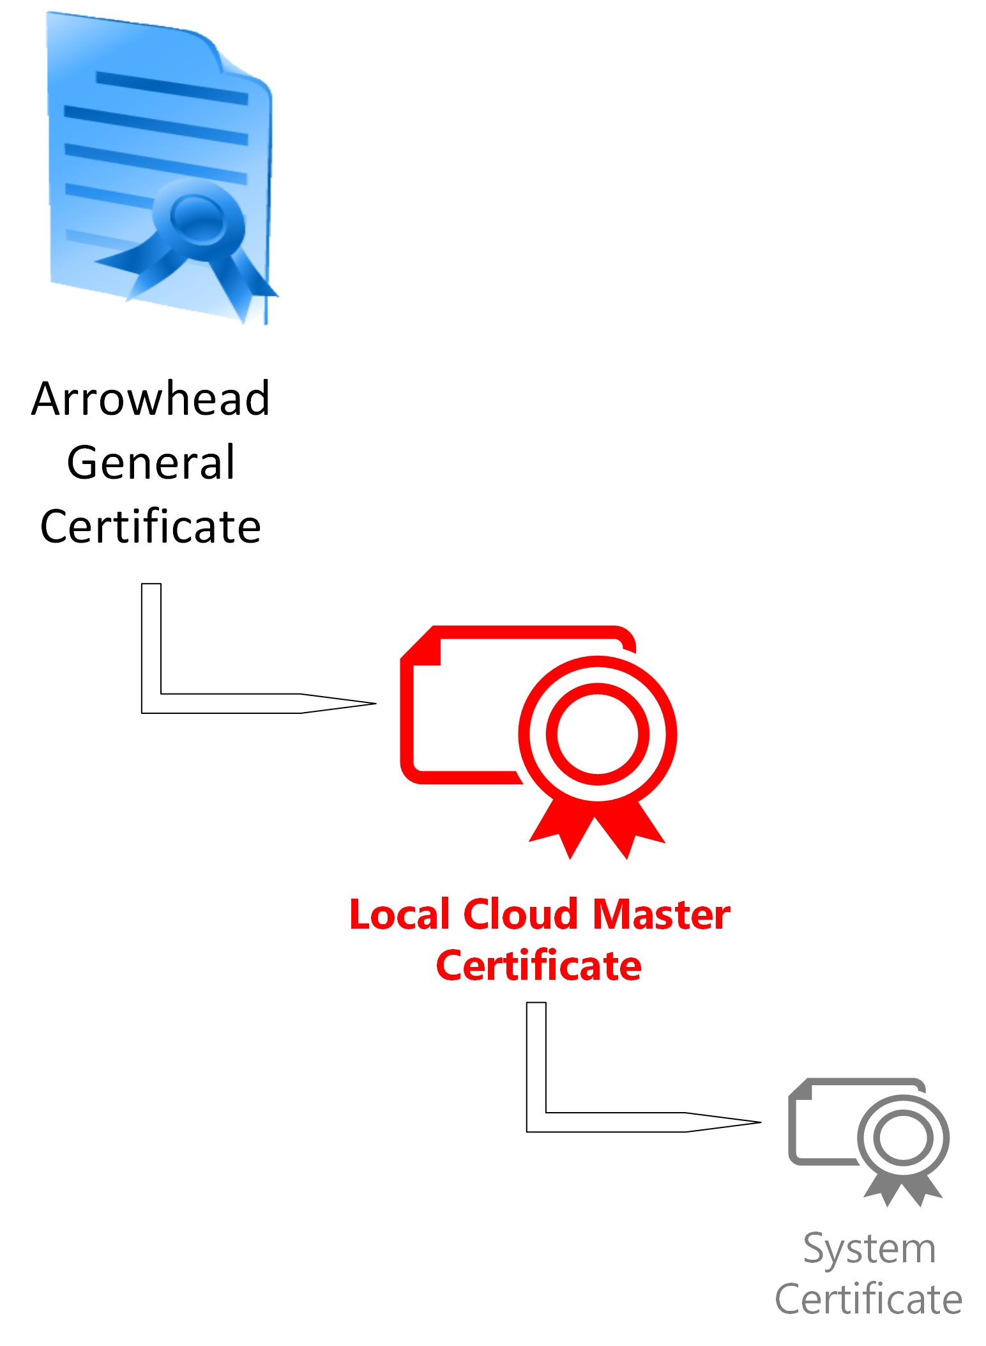
Certificate structure implemented within G3.2
May be self-signed or issued by e.g. Verisign
Managed by the AH consortium
Issued by the consortium when a new Local Cloud is deployed
AH Master CA
Cloud 1 CA
Cloud 2 CA
System A Certificate
System B Certificate
…
System M Certificate
System N Certificate
System O Certificate
…
System X Certificate
Issued by the local Authorization System upon BOOTSTRAPPING

Slide 12
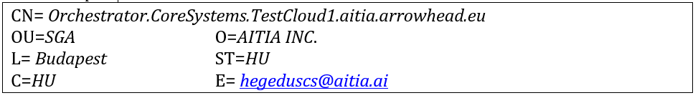
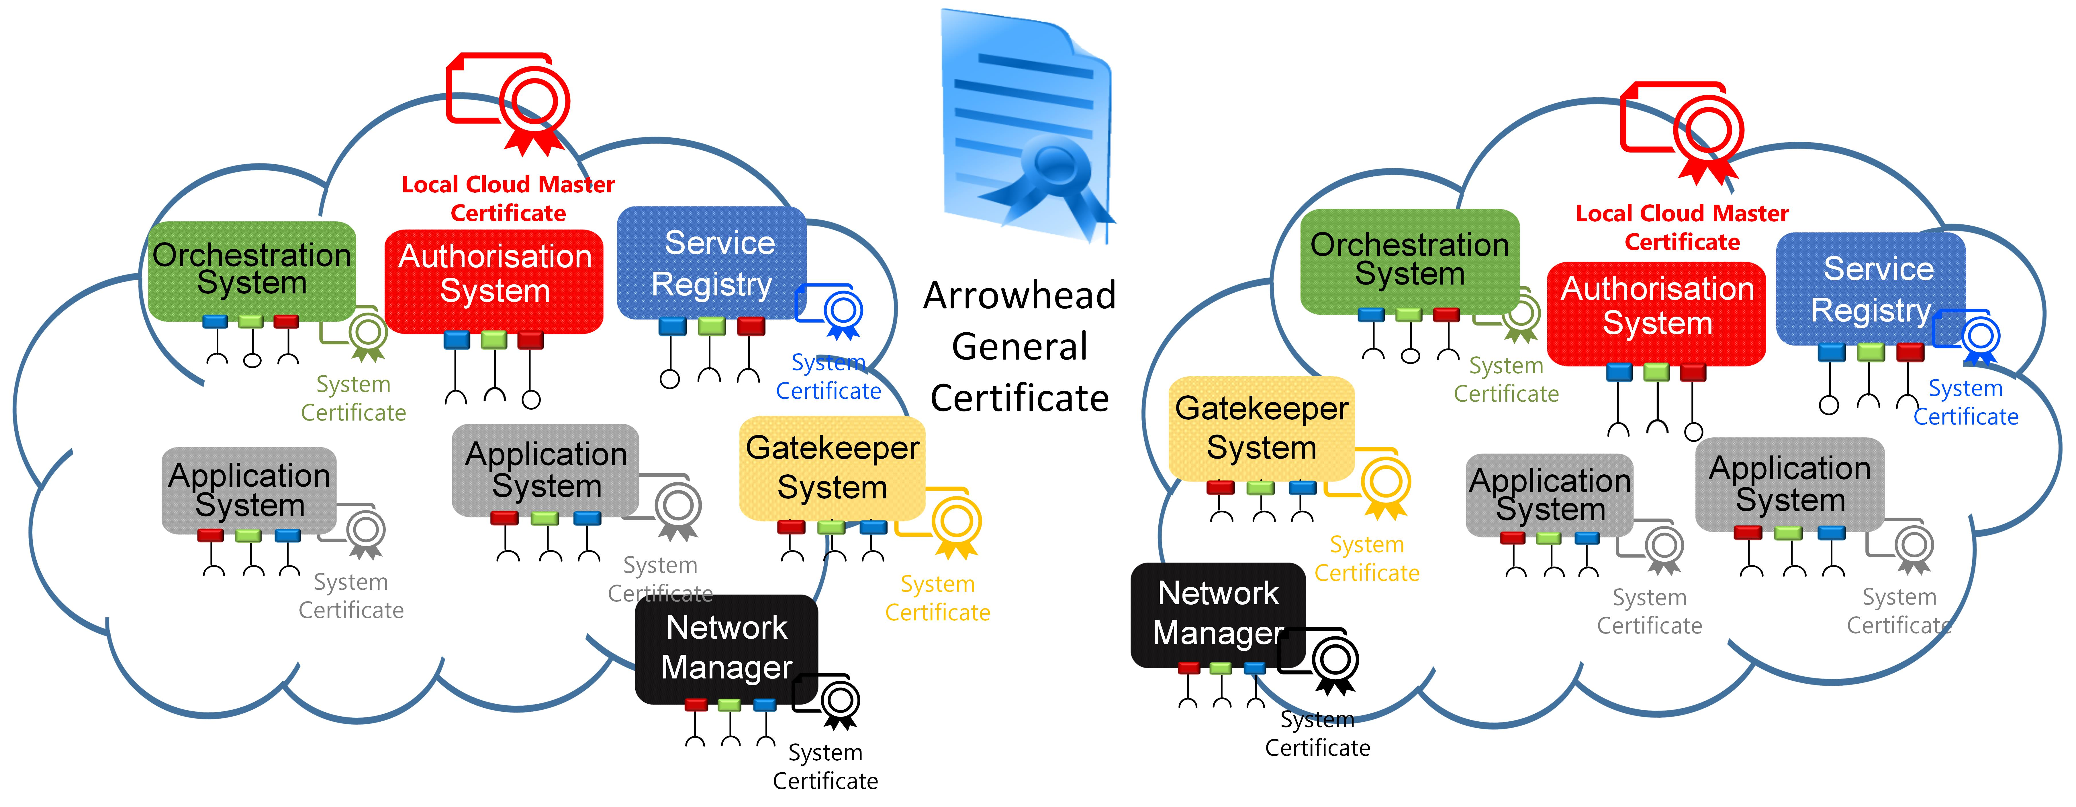
Certificate structure implemented within G3.2
Application
Authorisation
Authentication
Transport
Notes:
A Sys & Service hierarchiához illeszkedően definiáltuk az X.509 cert struktúrát.
Ezt a CN-ben implementáltuk és az Authorization System-re bíznánk a CA feladatkört. Jelenleg azonban manuális cert generálás van, mert ez egy bootstrapping folyamat része.
Implementation benefits

Slide 13
Transport level AA
All Core Systems implement:
Can check the inbound certificate
Is it signed by the Local Cloud certificate (trust store)?
If yes: it belongs to the LC (can interact with theCore Systems)
If no: it doesn’t belong to the LC (rejected)
Can only register to Service Registry if belongs to the LC
Using the G3.2 SR REST-based bridge towards the DNS-SD
Can only request Orchestratrion if belongs to the LC
All Systems should implement:
Check the Core Systems’ identity upon connection
No one should be able to pose as the Orchestrator
Can be done using the CN field
Can be certain if the partner’s certificate is signed by LC cert

Slide 14
Authorization System
The Authorization System stores public keys for all App. Systems
Within the AuthenticationInfo field; Base64 encoding of 2048 byte PublicKey
Using 2048 bit certificate → 244 bytes of token can be encrypted using simple RSA
Decryptable by on the System it was intended for
Since it is encrypted using its public key (decryptable by private one)
It is generated during the orchestration process
As a final step; after Consumer – Service – Provider trio has been set
By the local Authorization System, and based on the access rights stored in the database

Slide 15
Authorization System
In the future the Authorization System shall act as a Local Certificate Agency
There shall be a bootstrapping mechanism in which the „waking up” System gets its runtime configuration after identity verification.
This shall include the issue of an Arrowhead local runtime certificate.
The System should use this in its communications with the Core Systems.
All before-mentioned security solutions rely on this process.
With all CA functionalities (cert issue, revoke, validation), the AA System

Slide 16
The token itself
Two fields (SHA1withRSA; Base64)
Encrypted JSON (<=244 bytes)
Signature of the local Authorization System
Token Generation Service
Orchestrator
Authorization

Slide 17
RawTokenInfo
cipher = Cipher.getInstance("RSA/ECB/PKCS1Padding");
The encoded JSON:
{
„c”:”<SystemName>.<SystemGroup>.<CloudName>.<Operator>”,
„s”:”<interface>.<ServiceName>.<ServiceGroup>”,
„e”:”<endTimeInEpoch>”,
}
public class RawTokenInfo
{
private String s;
private String c;
private Long e;
}

Slide 18
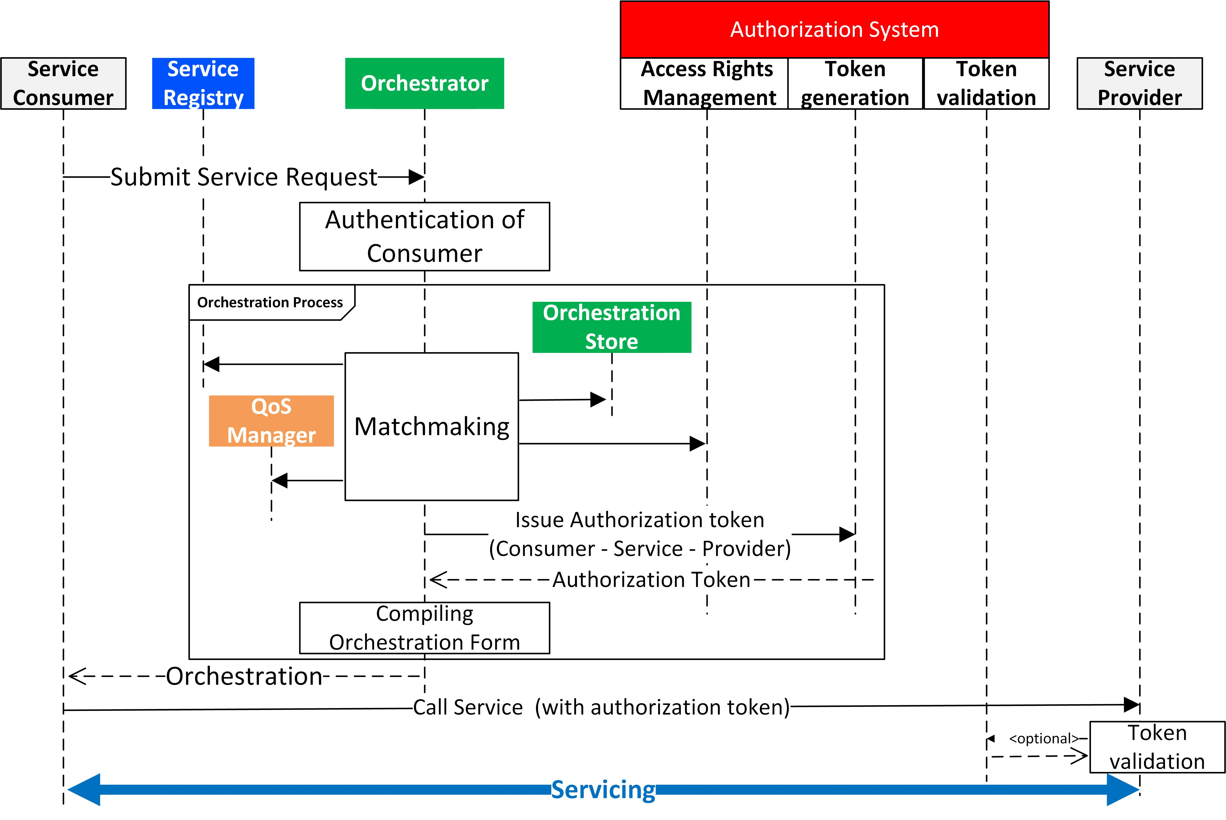
Token in the local orchestration process

Slide 19
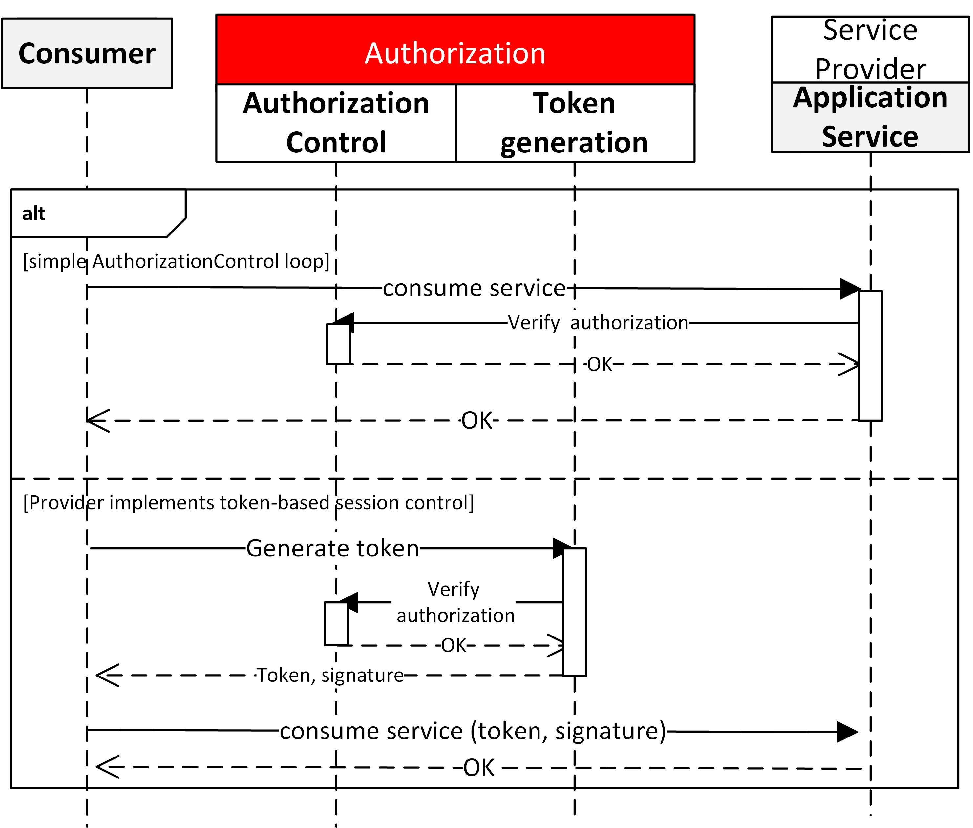
Token when no orch. process implemented

Slide 20
Security IN the Service and NOT AS a Service
Within the Application Service,
not defined by Arrowhead frame (how it is implemented within)!
It can be implemented for example:
Simple request-response cases (e.g. for REST)
As a request path parameter (as currently implemented)
GET to: /temperature&token=<value>&signature=<value>
if (consumer.equals(consumerWithToken)) {
if (endTime == 0L || (endTime > currentTime)) {
AllowConsumption();
}}
Within the HTTP header
Same concept

Slide 21
Consumer – Provider handshake
2. Persistent connection setup (e.g. Websocket)
Same as REST, in the initial connection shall contain these params
3. Publish-subscribe (MQTT, AMQP, OPC-UA)
The serviceURI can be a topicname.
The token handling is not defined yet.
Can be in the topic name or during a handshake

Slide 22
The Orchestrator/Consumer will know…
Service instances that implement various security measures shall have this information submitted to the SR as metadata.
„security” = „SSL”
„token” = „required”
Via the secure REST interface
Orchestration Process: If the Orchestrator fetches a Service Provider with a Service that contains these metadata descriptors is will automatically.
No orch. proc. Implemented: When the Consumer looks up the Provider, it can also detect these key-values.

Slide 23
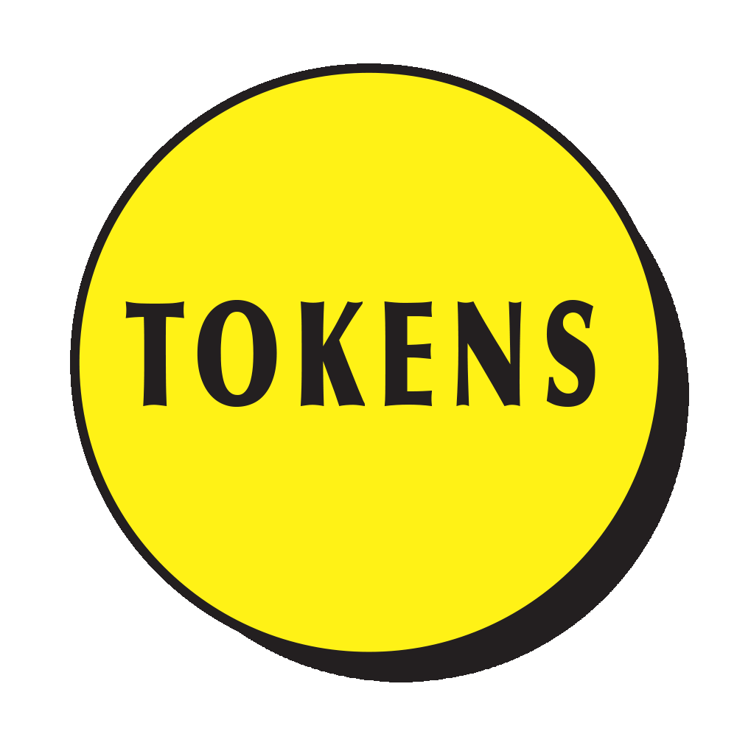
Inter-Cloud orchestration with the token
A
B
Orchestrator
3
4
Orchestrator
1
5
2
Gatekeeper
Gatekeeper
8
Authorization
7
9
7
9
Gateway
Gateway
Service Provider
10
10
10
Consumer

Slide 24
Benefits of this solution
Existing standard and implementation; core of the Internet
Chain of trust model → can be mapped to AH hierarchy
Assimetric key criptography
Assures confidentiality, integrity and authenticity of messages at the same time
Identity of a System is connected to its certificate.
Provider doesn’t have to know consumer previously
only have to trust the Authorization System of its Local Cloud
Authentication information can be extracted from the inbound client’s certificate
Can be used for authorization
Token generation
Which can also include logging (Accountability)

Slide 25
Benefits of this solution II.
Security within Services: handshake between Consumer and Provider
The token verifies that proper orchestration took place. Not an ad hoc connection attempt in the network (or malicious).
During the creation of the token:
Security logs can be made
Additional (e.g. billing related) services can be utilized.

Slide 26
Benefits of this solution III.
Usage of SSL is also not mandatory.
The token generation is not mandatory. Not all Services have to implement.
Secure and insecure Services can co-exist in an LC.
The Orchestrator knows will know from Service metadata when to force token generation and when not to bother.
There can be a secure (port 8080) and insecure (8443) Orchestrator instance as one entity for Systems of different security capabilities (resources).
The Orchestration service is stateless.
The token generation then can be triggered by:
The consumer (who knows that the Service type is a secure one, needs token to access it)
The Orchestration Store (future work) can contain this flag.

Slide 27
Benefits of this solution IV.
Bootstrapping process can be established
When new Systems are created and introduced to the LC
Automatic certificate generation and distribution
Inter-Cloud AAA is possible.
Gives us the possibility to govern how Local Clouds are established
LC certificate can only be issued by the Master Arrowhead CA
Which can be the consortium

Slide 28
Shortcomings / future work
Currently System certificates are generated manually
X509 certificates are based on PKI
Private key encryption (SSL) is resource demanding as is
There are several extensions / alternative solutions:
Lightweight certificates for sensor nodes
Elliptic Curve Cryptography (ECC) instead of RSA
Variable key security authentication
Standard and widely used protocols: Oauth with OpenID Connect
TODO
Vendor issued cert integration (vs. Bootstrapping)

Slide 29
Future work I.
Bootstrap mechanism
When a System first connects to the Local Cloud it shall be authenticated and authorized into the Cloud.
This can happen either with design-time allocation of Arrowhead-issued certificates
Or during an automated bootstrapping.
Using the original, vendor-issued certificate of the device
This can be even stored in a trusted platform module (TPM)
This certificate can be validated by a cooperation between:
System and Device Registries
Authentication System (Certificate Authority of the Local Cloud)
In the end of this process:
The vendor certificate shall be verified and identity confirmed (authentication INTO the LC)
System configuration shall be downloaded and System shall be ready to start
An Arrowhead runtime certificate shall be issued for the System which can be used to access other Core Systems and Application Systems.

Slide 30
Future work II.
Accounting
During token generation additional functionalities can be added.
Logging or financial services (e.g. payment services).
Since the token generation is a „symbol” for session establishment.
Here we need:
Security logging in the Core
Security logging by the Provider
Financial recording of the Service transaction.

Slide 31
?
Thank you!
hegeduscs@aitia.ai

